Slide 1
Supermarket Sales Dashboard
An Interactive Sales Monitoring System

Slide 2
Dashboard Objective
Provides a comprehensive, interactive overview of sales performance
Enable filter-based exploration by year, month, sale type, and payment mode
Highlight key KPIs, product-wise, and category-wise performance

Slide 3
Key KPIs
Total Sales: 401K
Total Profit: 69K
Profit %: 21%
Top Product: Product41 / 23K
Top Category: Category04 / 95K
These metrics are prominently displayed for quick decision-making.

Slide 4
Time-Based Insights
Monthly Trend (Bar + Line Combo):
Tracks sales and profit across months
Reveals peak & low performing periods
Daily Trend (Line Chart):
Visualizes daily sales patterns
Useful for identifying day-level anomalies or spikes

Slide 5
Product & Category Analysis
Top Products (Bar Chart):
Product 41, Product30, and Product42 lead sales
Scrollable visual for more product insights
Category View (Treemap):
Shows the share of each category in total sales
Visual size indicates revenue contribution

Slide 6
Sales & Payment Breakdown
Sales Type (Donut Chart):
Direct vs Online Sales
Quick % comparison
Payment Mode (Donut Chart):
Online vs Cash Transactions
Balanced split in customer preference

Slide 7
Interactive Navigation
Added buttons for seamless navigation:
Overview
Product
Payment
Each button linked to bookmarks, allowing focused, contextual analysis and quick return to the overview view.

Slide 8
Dashboard screenshot

Slide 9
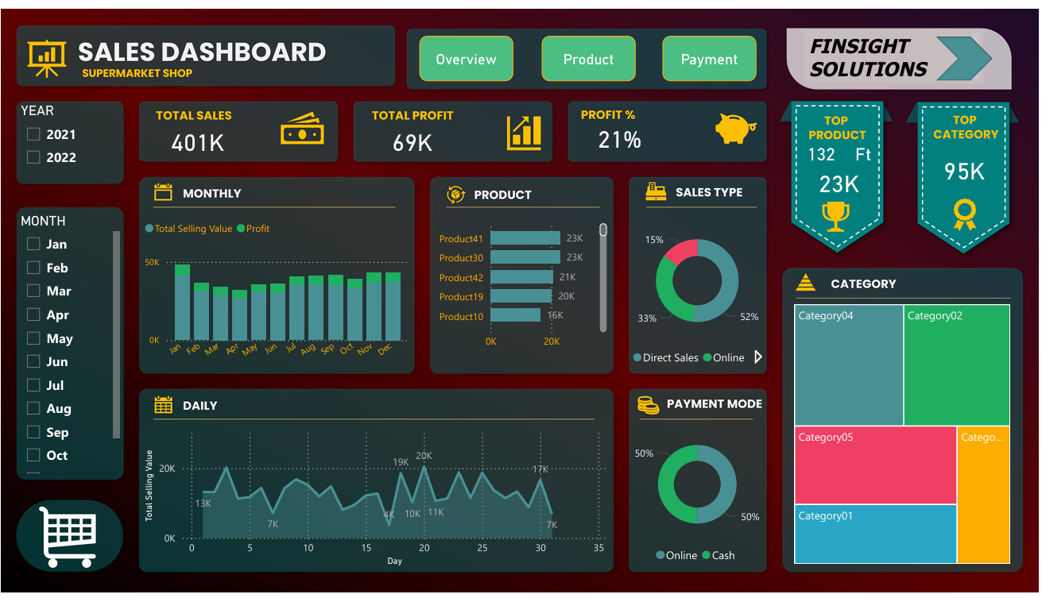

Slide 10
Highlights
Fully interactive and responsive layout
Dynamic filtering using Year, Month, Sale Type, Payment Mode
Branding and professional styling applied
Easy navigation across different analysis sections

